Slide 1
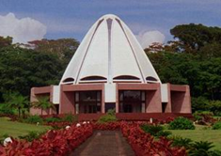
Musical Devotional for the Samoan Temple

Slide 2
O Thou kind Lord! We are servants of Thy Threshold, taking shelter at Thy holy Door. We seek no refuge save only this strong pillar, turn nowhere for a haven but unto Thy safekeeping. Protect us, bless us, support us, make us such that we shall love but Thy good pleasure, utter only Thy praise, follow only the pathway of truth, that we may become rich enough to dispense with all save Thee, and receive our gifts from the sea of Thy beneficence, that we may ever strive to exalt Thy Cause and to spread Thy sweet savors far and wide, that we may become oblivious of self and occupied only with Thee, and disown all else and be caught up in Thee.
O Thou Provider, O Thou Forgiver! Grant us Thy grace and loving-kindness, Thy gifts and Thy bestowals, and sustain us, that we may attain our goal. Thou art the Powerful, the Able, the Knower, the Seer; and, verily, Thou art the Generous, and, verily, Thou art the All-Merciful, and, verily, Thou art the Ever-Forgiving, He to Whom repentance is due, He Who forgiveth even the most grievous of sins.
('Abdu'l-Bahá, Baha'i Prayers, p. 21)

Slide 3
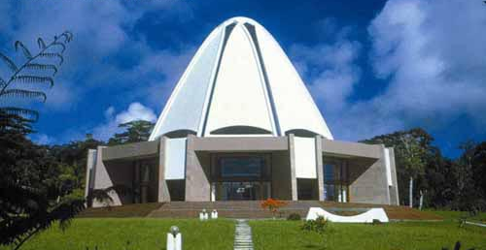
Prayer in Oro Language
O God, guide me, protect me, make of me a shining lamp and a brilliant star. Thou art the Mighty and the Powerful.
('Abdu'l-Bahá, Baha'i Prayers, p. 36)
(“O Mama”)

Slide 4
"It is understandable that Bahá'ís who witness the miserable conditions under which so many human beings have to live, or who hear of a sudden disaster that has struck a certain area of the world, are moved to do something practical to ameliorate those conditions and to help their suffering fellow-mortals.
"There are many ways in which help can be rendered. Every Bahá'í has the duty to acquire a trade or profession through which he will earn that wherewith he can support himself and his family; in the choice of such work he can seek those activities which are of benefit to his fellow-men and not merely those which promote his personal interests, still less those whose effects are actually harmful.
"There are also the situations in which an individual Bahá'í or a Spiritual Assembly is confronted with an urgent need which neither justice nor compassion could allow to go unheeded and unhelped. How many are the stories told of 'Abdu'l-Bahá in such situations, when He would even take off a garment He was wearing and give it to a shivering man in rags.
(From a letter written on behalf of the Universal House of Justice to the National Spiritual Assembly of Italy, November 19, 1974) (Compilations, Lights of Guidance, p. 122)

Slide 5
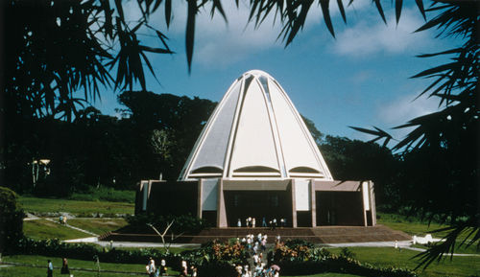
Prayer in Nalik Language
Is there any Remover of difficulties save God? Say: Praised be God! He is God! All are His servants, and all abide by His bidding!
(The Báb, Baha'i Prayers, p. 27)
(“Tamon amun zun”)

Slide 6
"But in our concern for such immediate obvious calls upon our succour we must not allow ourselves to forget the continuing, appalling burden of suffering under which millions of human beings are always groaning -- a burden which they have bourne for century upon century and which it is the Mission of Bahá'u'lláh to lift at last. The principal cause of this suffering, which one can witness wherever one turns, is the corruption of human morals and the prevalence of prejudice, suspicion, hatred, untrustworthiness, selfishness and tyranny among men. It is not merely material well- being that people need. What they desperately need is to know how to live their lives -- they need to know who they are, to what purpose they exist, and how they should act towards one another; and, once they know the answers to these questions they need to be helped to gradually apply these answers to every-day behavior. It is to the solution of this basic problem of mankind that the greater part of all our energy and resources should be directed...“
(From a letter written on behalf of the Universal House of Justice to the National Spiritual Assembly of Italy, November 19, 1974) (Compilations, Lights of Guidance, p. 122)

Slide 7
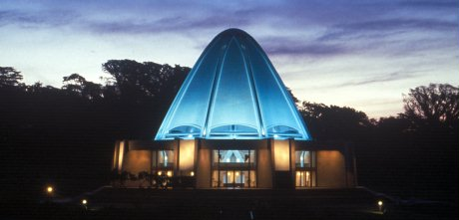
Prayer in Motu Language
O God, guide me, protect me, make of me a shining lamp and a brilliant star. Thou art the Mighty and the Powerful.
('Abdu'l-Bahá, Baha'i Prayers, p. 36)
(“Dirava e oi hakaugu”)

Slide 8
O people of the world! Build ye houses of worship throughout the lands in the name of Him Who is the Lord of all religions. Make them as perfect as is possible in the world of being, and adorn them with that which befitteth them, not with images and effigies. Then, with radiance and joy, celebrate therein the praise of your Lord, the Most Compassionate. Verily, by His remembrance the eye is cheered and the heart is filled with light.
(Baha'u'llah, The Kitab-i-Aqdas, p. 29)

Slide 9
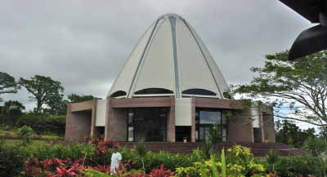
O Friend
O FRIEND! In the garden of thy heart plant naught but the rose of love, and from the nightingale of affection and desire loosen not thy hold. Treasure the companionship of the righteous and eschew all fellowship with the ungodly.
(Baha'u'llah, The Persian Hidden Words)

Slide 10
In brief, the original purpose of temples and houses of worship is simply that of unity -- places of meeting where various peoples, different races and souls of every capacity may come together in order that love and agreement should be manifest between them. That is why Bahá'u'lláh has commanded that a place of worship be built for all the religionists of the world; that all religions, races and sects may come together within its universal shelter; that the proclamation of the oneness of mankind shall go forth from its open courts of holiness -- the announcement that humanity is the servant of God and that all are submerged in the ocean of His mercy. It is the Mashriqu'l-Adhkar. The world of existence may be likened to this temple and place of worship. For just as the external world is a place where the people of all races and colors, varying faiths, denominations and conditions come together -- just as they are submerged in the same sea of divine favors -- so, likewise, all may meet under the dome of the Mashriqu'l-Adhkar and adore the one God in the same spirit of truth; for the ages of darkness have passed away, and the century of light has come.
(Abdu'l-Baha, The Promulgation of Universal Peace, p. 65)

Slide 11
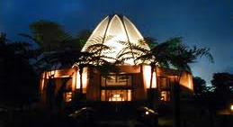
Prayer in Solomon Language
O God, guide me, protect me, make of me a shining lamp and a brilliant star. Thou art the Mighty and the Powerful.
('Abdu'l-Bahá, Baha'i Prayers, p. 36)
(“Hu Bagege”)

Slide 12
Make firm our steps, O Lord, in Thy path and strengthen Thou our hearts in Thine obedience. Turn our faces toward the beauty of Thy oneness, and gladden our bosoms with the signs of Thy divine unity. Adorn our bodies with the robe of Thy bounty, and remove from our eyes the veil of sinfulness, and give us the chalice of Thy grace; that the essence of all beings may sing Thy praise before the vision of Thy grandeur. Reveal then Thyself, O Lord, by Thy merciful utterance and the mystery of Thy divine being, that the holy ecstasy of prayer may fill our souls - a prayer that shall rise above words and letters and transcend the murmur of syllables and sounds - that all things may be merged into nothingness before the revelation of Thy splendor.
Lord! These are servants that have remained fast and firm in Thy Covenant and Thy Testament, that have held fast unto the cord of constancy in Thy Cause and clung unto the hem of the robe of Thy grandeur. Assist them, O Lord, with Thy grace, confirm with Thy power and strengthen their loins in obedience to Thee. Thou art the Pardoner, the Gracious.
('Abdu'l-Bahá, Baha'i Prayers, p. 69)

Slide 13
Kindle the Fire of Love
Kindle the fire of love
Burn away your veils
Then set they feet
Into the land of thy lovers

Slide 14
Consult the letter from the National Spiritual Assembly in regards to donations to support Samoa.

